Slide 1
NEWTON RAPHSON METHOD
NAZMUL KADER CHOWDHURY

Slide 2
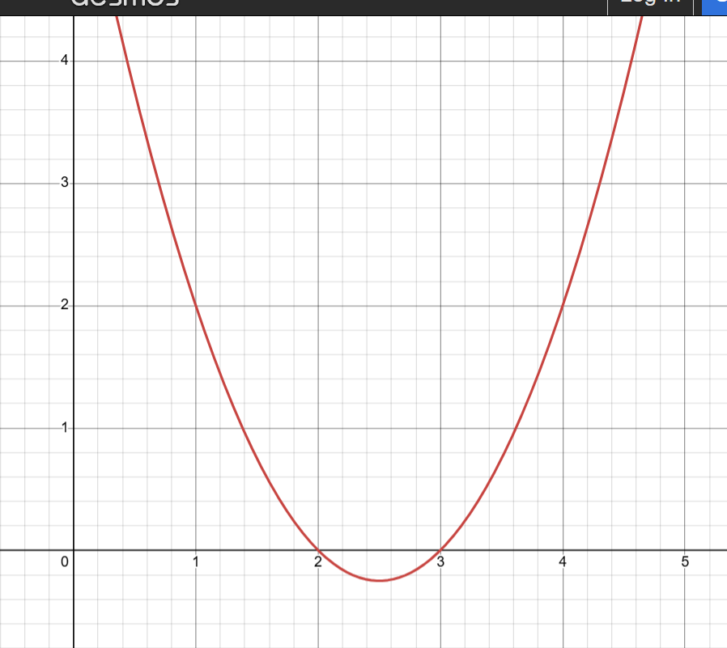
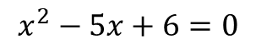
Brief Idea of Solving y = f(x):
To find the solution of y = f(x), we seek the value of x where f(x) = 0 or y=0.
$$x^{2}−5x+6=0$$

Slide 3
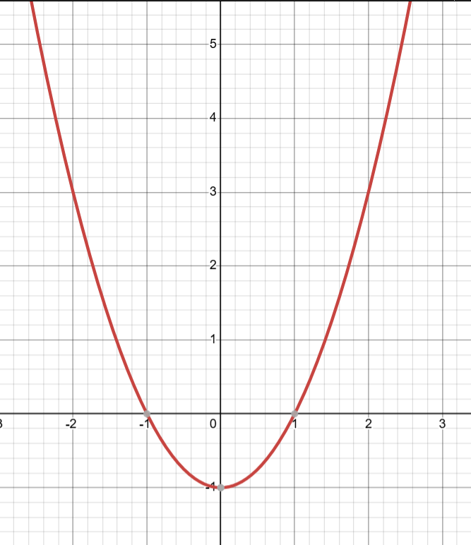
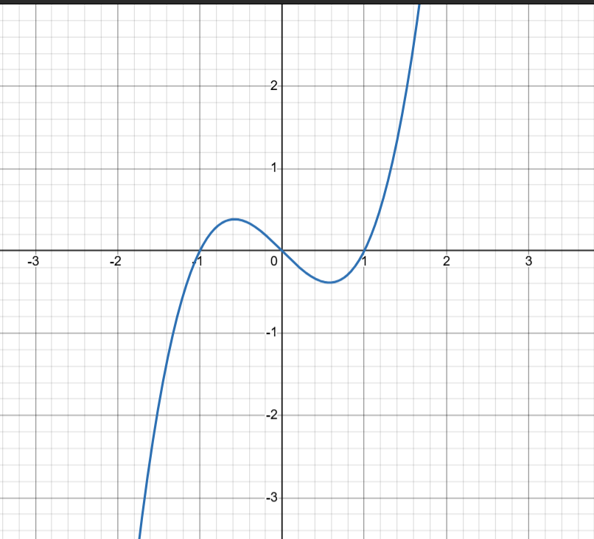
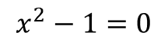
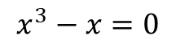
$$x^{3}−x=0$$
$$x^{2}−1=0$$

Slide 4
Introduction:
An iterative numerical method for finding roots of real-valued functions.
Also known as the Newton Method.

Slide 5
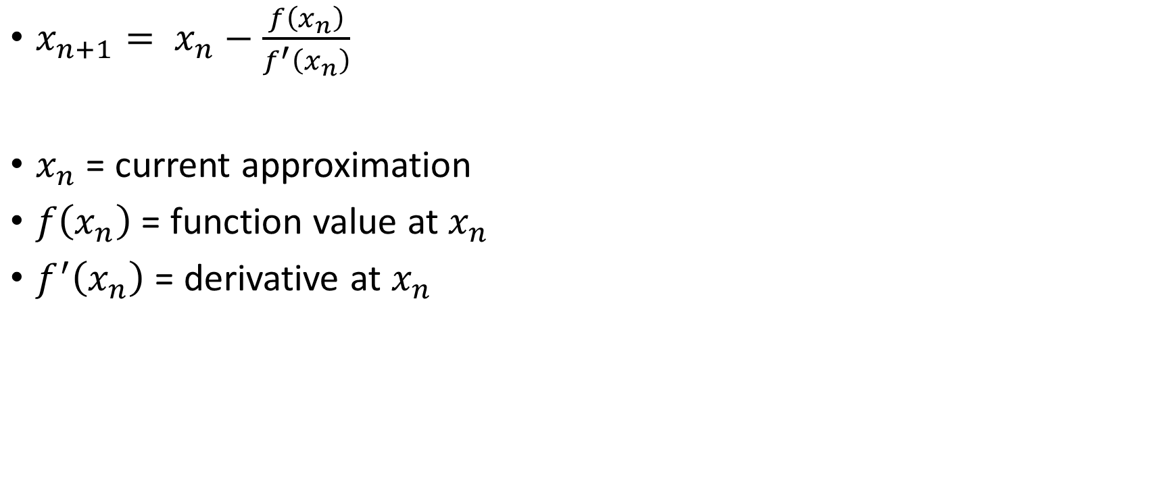
FORMULA
$x_{n+1}= x_{n}−\frac{f\left(x_{n}\right)}{f^{′}\left(x_{n}\right)}$
$x_{n}$ = current approximation
$f\left(x_{n}\right)$ = function value at $x_{n}$
$f^{′}\left(x_{n}\right)$ = derivative at $x_{n}$

Slide 6
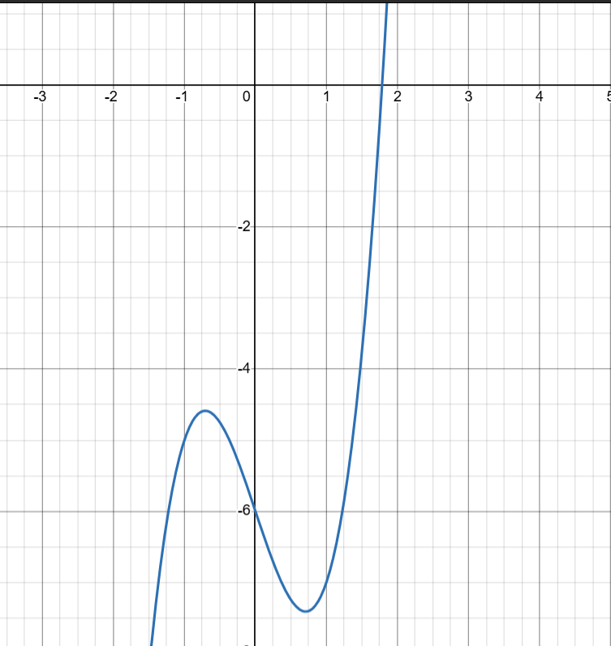
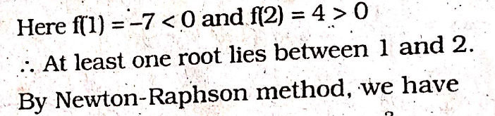

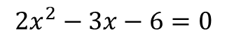
SOLVING ${2x}^{3}$+3x-6 USING NEWTON RAPHSON METHOD
Step 1: Initial guess
$${2x}^{2}−3x−6=0$$

Slide 7
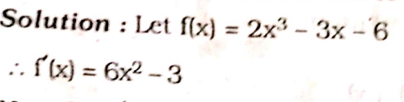
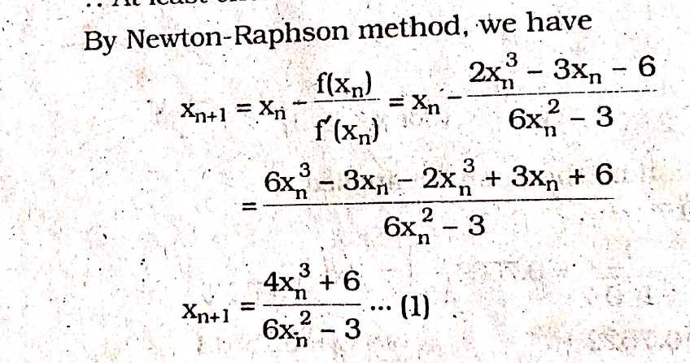
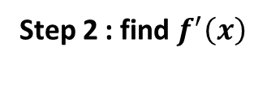
Step 2 : find $f^{′}\left(x\right)$
Step 3 Apply the Newton-Raphson Formula:

Slide 8
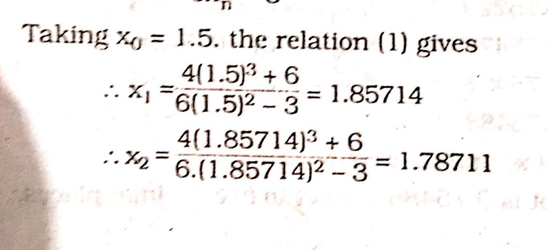
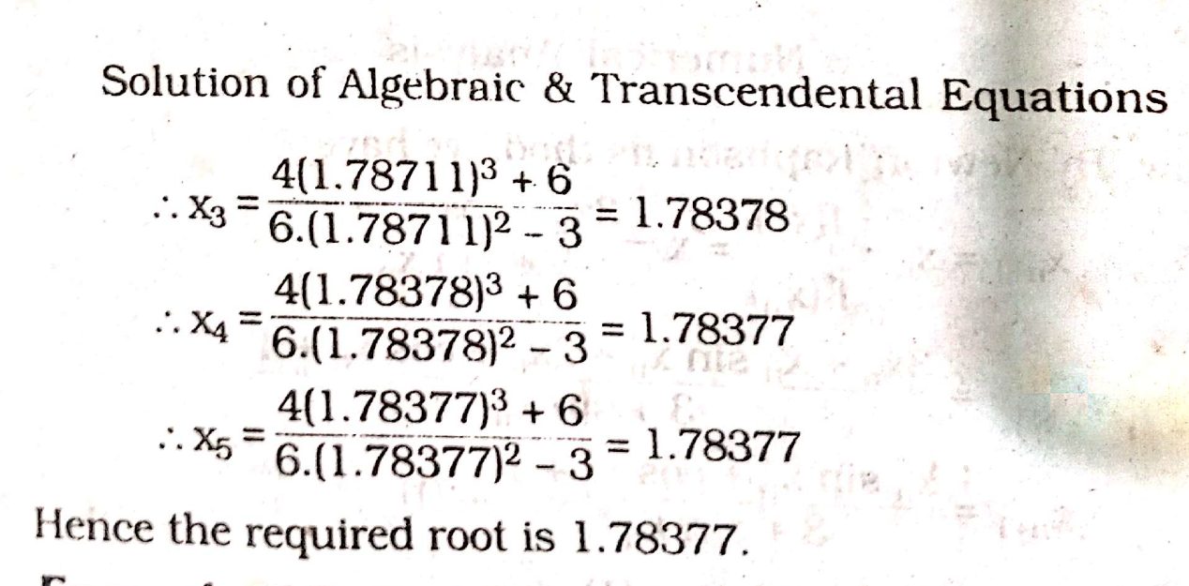
Step 4: iteration

Slide 9
Problem 2
Find the roots of $x^{3}= 6x+4$ using Newton-Rapson method.

Slide 10
“The only way to learn mathematics is to do mathematics.”
-------- Paul Halmos

